Slide 1

Course Title:
The Modern Novel
Instructor:
Dr Abdulgawad Elnady
Associate Professor of Literature, Department of English,
King Faisal University.
King Faisal University
Deanship of E-Learning
1

Slide 2
Fifth Lecture

Slide 3
Quick Revision
We studied the relationship between the Wolf and the Lamb and Animal Farm, saying that both works are attacks against dictatorship, whether before or after the revolution. As the last line of “The Wolf and the Lamb” says,
A Tyrant will always find an excuse
An excuse for treating people badly
An excuse for justifying all his or her maltreatment of people.
Both forms have been quite effective in expressing the points of view of writers.

Slide 4
What is the setting of the novel?
Time (the 20th century, the modern age)
place: a farm somewhere in England. This means that we expect the writer to talk about the conditions of people in England. But of course the events of the novel talk originally about Russia.
So there is a change of setting to escape from any accusation that the writer is directly with or against a certain government.

Slide 5
Question
Does the novel have animal characters only? Don't we have human beings as characters?
Mr Jones is the owner of the farm.
He is described as a tyrant who takes control of the animals and does not feed them well.

Slide 6
Question
What is the attitude of the animals? Do they just sit silent without resisting?
They start to notice all these forms of injustice and inequality they suffer from, but they cannot do anything to it simply because they have been used to not thinking, not protesting.
What they need is a leader to push them forward, to lead them into action.

Slide 7
The Novel
Remember the leaders of the French Revolution? In exactly the same circumstances, people suffered a lot until Voltaire, Rousseau, and Montesquieu came over and led them into the French Revolution against the dictatorial monarch that ruled France at that time and which brought about lots of changes in France.

Slide 8
The Novel
Almost every piece of information that you read in the novel has a basis in reality. In the second paragraph, we read about Old Major. In reality, Old Major represents Karl Marx, the communist thinker who called for equality and fraternity and liberty.

Slide 9
The Novel
Karl Marx offered a solution to the problems of people. According to him, the main problem was inequality X equality. Some people were richer, better, and more distinguished. The others were poorer, worse, and less distinguished. Solution: equality. There shouldn’t be any differences between classes of people in terms of power, fame, money, even appearance. Communism

Slide 10
What is Communism?
A school of thought, a movement that meant:
All property and wealth is owned by all members of the society.
Famous thinker: Karl Marx

Slide 11

Romanovs
Old Russia had been ruled for 300 years by a family called the Romanovs. They were called czars (or tsars) and ruled as kings and queens.
They lived a fantastic life in their palace, surrounded by all kinds of luxuries.

Slide 12
The Romanovs ruled without challenge for a long time. In 1914, Russia was involved in World War I and fought Germany. Czar Nicholas, the king, went with his troops to the battles in the frozen north.
Five months into the war, Russia had lost 400,000 men. They would eventually lose 2 million.

Slide 13

Things at home weren’t good either. It was bitter cold, and there wasn’t enough food to go around. People who were already tired of the Czar’s life of privilege began to talk of Revolution.

Slide 14

Vladmir Lenin was the man who was, in large part, responsible for leading the revolution against the Romanovs.

Slide 15
Vladmir Lenin and Karl Marx were the two men who sparked the Russian Revolution and originated the idea of “Communism”.
Communism is a political system where all members are supposedly equal, and all work for the good of the system. Lenin and Marx encouraged the overthrow of the Czar and his family in order to clear the way for equality for all, at least in theory.

Slide 16
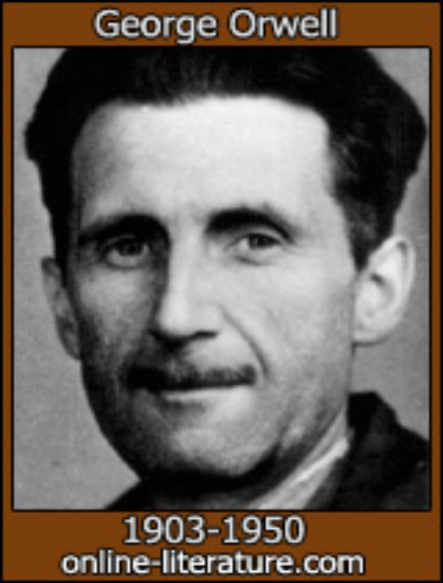
George Orwell, a writer who was born in 1903, was intrigued by the Russian Revolution and decided to write an allegory about it. An allegory is a story where symbols or symbolic characters are used to portray real people or things.

Slide 17
Orwell wanted to expose what he called the “myth” of the Soviet system. He felt that because of human behavior and greed, such a system could never function.
His book, ANIMAL FARM, could not be published until 1945, after war had ceased.

Slide 18
“Man is the only real enemy we have. Remove Man from the scene, and the root cause of hunger and overwork is abolished for ever. Man is the only creature that consumes without producing. He does not give milk, he does not lay eggs, he is too weak to pull the plough, he cannot run fast enough to catch rabbits. Yet he is lord of all the animals. He sets them to work, he gives back to them the bare minimum that will prevent them from starving, and the rest he keeps for himself.”- George Orwell, ANIMAL FARM

Slide 19

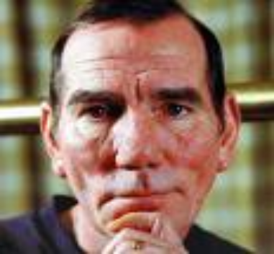
Characters in ANIMAL FARM and who they represent
Mr. Jones
The owner of Manor Farm. He forces the animals to work and doesn’t take good care of them. He has a good life but doesn’t share his good fortune with the animals, and they feel mistreated.
Czar Nicholas
The king of Russia, from a dynasty 300 years in the making. He lived well while Russian peasants starved. Married to Alexandra, several children.
=

Slide 20
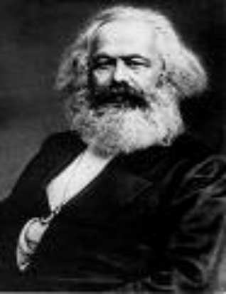
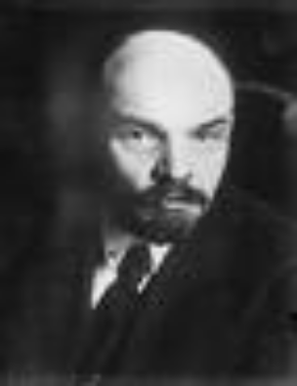
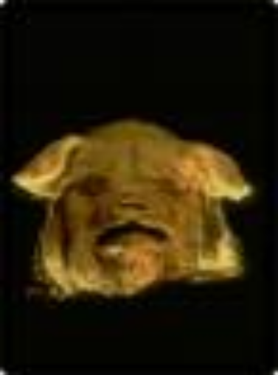
Karl Marx/Vladmir Lenin
These two men came up with the theory of Communism and inspired others to pursue the Revolution.
Old Major
The oldest pig on the farm, he has a dream and comes up with the idea of an animal revolution against man.
=

Slide 21
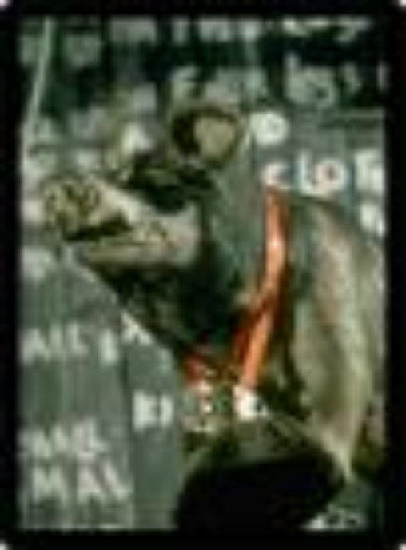
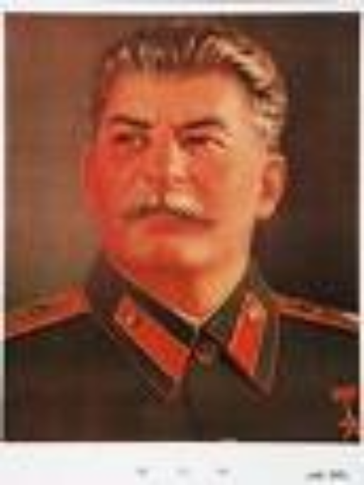
Josef Stalin
Stalin had a power struggle with Leon Trotsky for the direction Russia (or the Soviet Union) would take after the Revolution
Napoleon
A pig who fights with Snowball for control of the farm. He says he wants good conditions for all, but is really greedy.
=

Slide 22
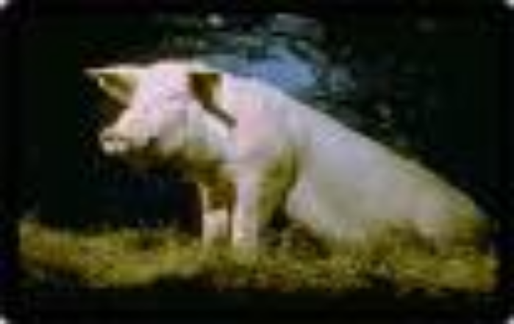
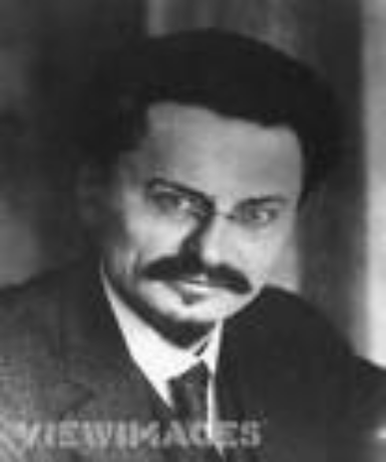
Leon Trotsky
One of the revolutionary leaders who favored Socialism over Communism. He wanted better conditions and education for the common man, and was exiled to Mexico by Stalin.
Snowball
An intellectual pig who wants good conditions and education for all the animals. He is betrayed by Napoleon and exiled from the farm.
=

Slide 23
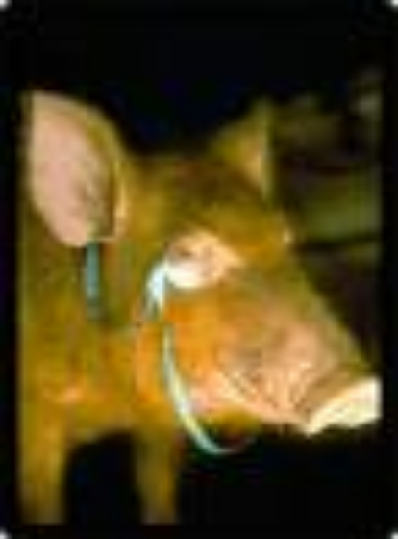
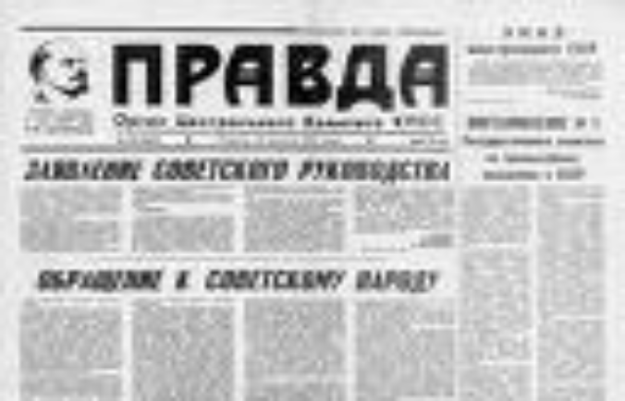
Pravda
A state-run newspaper that was used by Stalin to control news, information and propaganda.
Squealer
A pig who acts as Napoleon’s “mouthpiece” and he lies to cover up the crimes Napoleon commits.
=

Slide 24
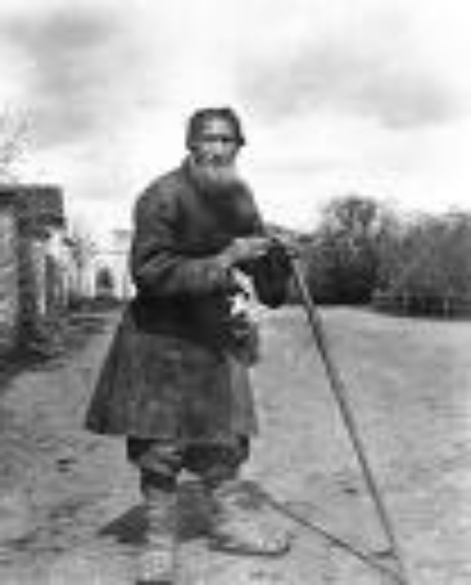
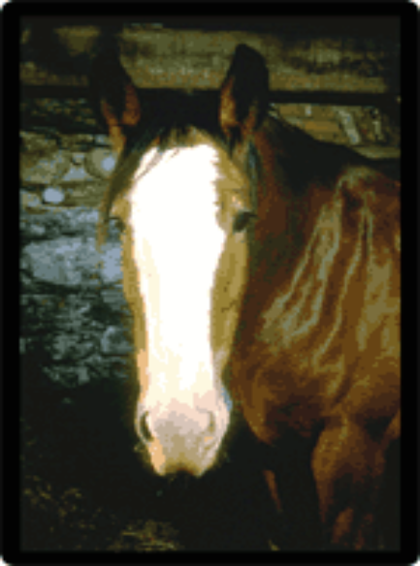
Russian workers
The “proletariat”, or common workers, made Stalin’s Soviet regime work. They did not benefit from their hard work.
Boxer
A horse whose motto was “I will work harder” and “Napoleon is always right.”
=

Slide 25
Pigs: they represent the Communist party
Dogs (puppies): they represent the KGB secret police
Moses the Raven: represents Orwell’s idea that religion is used to keep people confused
Sheep: they represent people who are blind followers and who don’t think for themselves.
Other humans: represent different countries that had dealings with the Soviet Union (Hitler’s Germany, Churchill’s England, etc.)

Slide 26
Czarist supporters
Some Russians remained loyal to the Czar. They are called ‘czarists’ and they had usually benefited from the Czar’s lavish lifestyle.
Mollie
A white horse who loves the ribbons and sugar the humans gave her. She misses the old days.

Slide 27

بحمد الله

