Slide 1
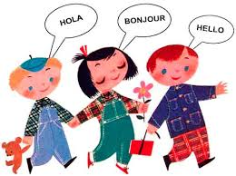
Language maintenance and shift
Chapter: 3 of The Book
“An Introduction To Sociolinguistics
By Janet Holmes”.
P.53 To 75

Slide 2

- Language Shift In Different Communities
(Migrant - Non-Migrant).
- Factors Contributing To Language shift.
- Migrant Majorities.
By: Hawra Al-Mehsen

Slide 3
Language Shift In Different Communities
Migrant Minorities:
The order of domains in which language shifts occurs may differ for different individuals and different groups, but gradually over time the language of the wider society displaces the minority language mother tongue. EX 1, P.53.
Why Do We Need To Shift ?!
1- To assimilate the original monolingual community.
2- To be a member of the new community.
In countries like England the school is one of the first domains in which children of migrant families meet English. So, they have to use English because it is the only means of communicating with others.

Slide 4
There is a pressure from the wider society, too. Immigrants who look and sound different are often regarded as threatening by majority group members.
For instance, language shift to English has often been expected of migrants in predominantly monolingual countries such as England and U.S. Speaking good English is a sign of successful assimilation.
So most migrant families shift from using Gujerati, or Vietnamese to each other most of the time, to using English. This may take three or four generations to complete the shift, but sometimes language shift is completed in just two generation.
Migrants are virtually monolingual in their mother tongue, their children are bilingual and their grandchildren are often monolingual in the language of host country. We can observe the shift by noting the change’s in people’s patterns of language use in different domains over time.

Slide 5
Non- Migrant Community:
Language shift is not always of the result of migration. Political, economic and social changes can occur within a community, and this may result in linguistic changes too.
For Example, in Oberwart, an Austrian town on the border of Hungary, the community has been gradually shifting from Hungarian to German for some time.
The language use for any individual in Oberwart in the 1970s depends on their social networks.
Table 3.1 P.56 showed interactions between older people and peasants tended still to be in Hungarian, and interactions between younger people and those working in jobs associated with the new industries.

Slide 6
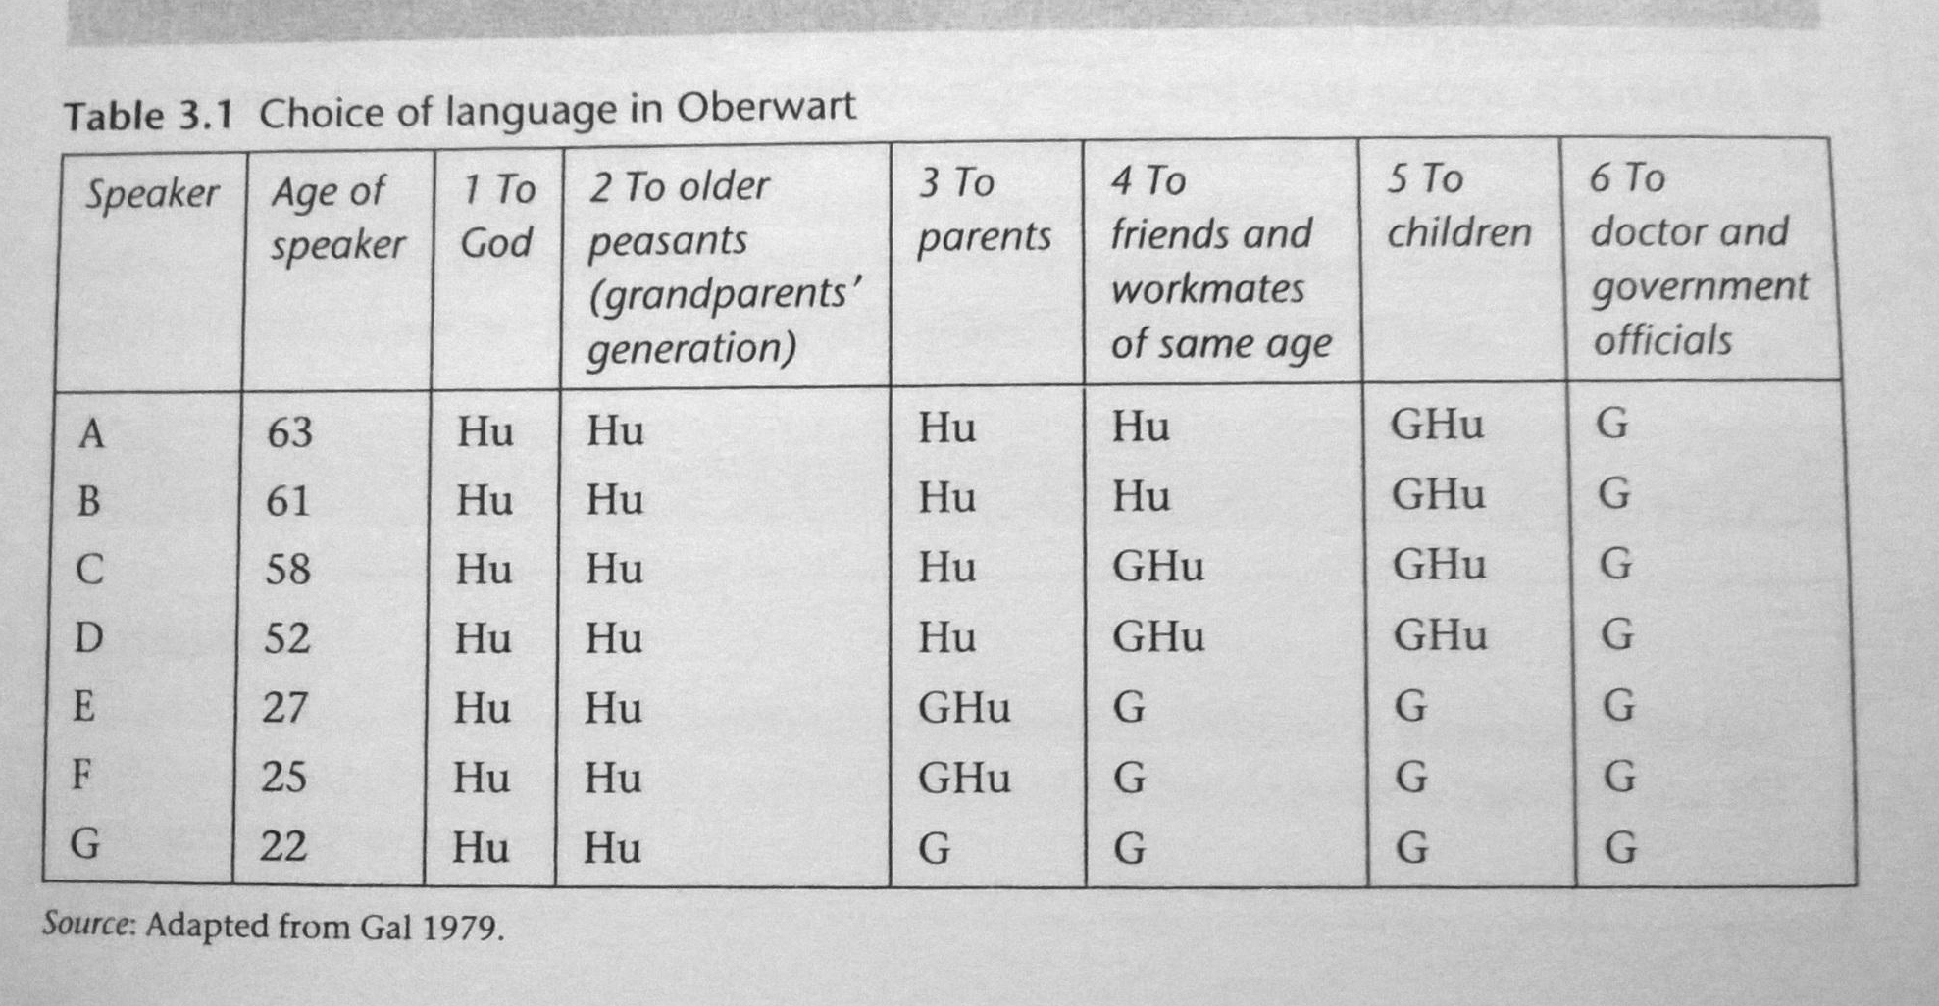
The pattern of the table suggests that German will gradually completely displace Hungarian in Oberwart.

Slide 7
Migrant Majorities:
The language shift often indicates the influence of political and economic factors. Such as the need of work.
When colonial powers invade other countries their language often become dominant.
Multilingualism was too well-established as normal in countries like India and New Guinea.
The result of colonial economic and political control was not diglossia with varying degree of bilingualism as found in many African, Asian and South America Countries, but the more or less complete eradication of the many indigenous languages.

Slide 8
Over time the countries shifted to the coloniser’s language, English and their own languages died out.
When languages shift occurs, it is almost shift towards the language of the dominant powerful group.
The dominant language is associated with:
1- High Statue.
2- Prestigious.
3- Social Success Communities.

Slide 9
Factors contributing to Language Shift:
1
2
3
Economic Factor: Seller & Buyer.
Demographic Factor: Minority & Majority.
Social Factor: Poor & Wealth.
4
Political Factor: Ruled & ruler.

Slide 10

- Language Revival.
- Language Vitality.
By: Noor Al-Sada

Slide 11
How can a minority be maintained ?
If a language is an important identity marker
If a minority group is cohesive
If a minority group keeps close contact with the homeland
If a minority language gets institutional support
For example, In the USA, Chinese people who live in the Chinatown areas of big cities are much more likely to maintain a Chinese dialect as their mother tongue through to the third gene who moved outside the Chinatown area.

Slide 12
Language Revival:
Community becomes aware that its language is in danger of disappearing and takes deliberate steps to revitalize it . Attempts have been made in Ireland, Wales and Scotland
The success of such efforts will depend on :
How far language loss has occurred –there is a point of no return-
How strongly people want to revive the language
Their reasons for doing so . for example , Hebrew was revived in Israel after being effectively dead for nearly 1700 years . It has survived only for payers and reading sacred . Strong feelings of nationalism led to determined efforts by Israel adults to use it to children , and as a result it has been successfully revived .

Slide 13
What brings dead language back to life ?
New Zealand : Maori ( cultural crisis )
Israel : Hebrew ( nationalism )
Taiwan : Taiwanese ( political independence )
Scotland : Scotch ( cultural identity )
Who brings dead languages back to life ?
Acceptance by :
People
Institutions ( government, university, church and media )

Slide 14
Language Vitality:
A language will last long and remain strong in a community if :
The social status of the target language speakers remains high
The number of people using the target language remains large
Institutional support to the target language remains high
Ethnolinguistic vitality :
There are Three factors to assess ethnolinguistic vitality
Social status of the speakers
Demographic strength
Institutional support

Slide 15

- Language Death and Loss.
- The reasons of Language Loss.
- Endangered Languages.
- Potentially Endangered.
- Attitudes and Values.
By: Zahra Al-Sadiq

Slide 16
Language death and language loss:
Language Death:
This is a process that occurs when a language is no longer spoken naturally anywhere in the world.
In 2011, British newspapers reported that Ayapaneco, an indigenous language of Mexico, danger of dying out as the only two remaining fluent speakers (aged 75 and 69) refused to talk to each other.
The previous report conceals a much more complex.

Slide 17
Firstly, the name Ayapaneco for the language was given by outsiders; the two men actually call it Nuumte Oote (True Voice).
Secondly, no one actually knows why the two men do not speak to each other. There may be cultural reasons for their behavior, e.g. an 'avoidance relationship', as appropriate in some Australian Aboriginal cultures.
Thirdly, and most relevantly for the discussion in this chapter, the reasons for the disappearance of Ayapaneco can more accurately be linked to factors such as the increasing urbanisation of the population, and the political decision to introduce compulsory education in Spanish, rather than to the lack of communication between these two old men.

Slide 18
It is generally true that when all the people who speak a language die, the language dies with them.
In 1992, when Tefvik Esenc died, so did the linguistically complex Caucasian language Ubykh.
Manx has now completely died out in the Isle of Man – the last native speaker, Ned Maddrell, died in 1974.
Cornish effectively disappeared from Cornwall in the eighteenth century when Dolly Pentreath of Mousehole died in 1777

Slide 19
than half of the 250-300 Aboriginal languages spoken in Australia when the Europeans arrived have survived, and fewer than two dozen are being actively passed on to younger generations.
Many disappeared as a direct result of the massacre of the Aboriginal people, or their death from diseases introduced by the Europeans
In Tasmania, the whole indigenous population of between 3000 and 4000 people was exterminated within 75 years. Their languages died with them.
the Turkish community in Britain, may shift to English voluntarily . This involves the loss of the language for the individuals concerned, and even for the community in Britain

Slide 20
When a language dies gradually, as opposed to all its speakers being wiped out by a massacre or epidemic, the process is similar to that language shift.
The functions of the language are taken over in the domain after another by another language.
As the domains in which speakers use the language shrink, the speakers of the dying language become gradually less proficient in it.

Slide 21
Annie at 20 is a young speaker of the Dyirbal, an Australian Aboriginal language. She also speak English which she learned at the school. There is no written Dyirbal material for her to read, and there are fewer and fewer contexts in which she can appropriately hear and speak the language. So she is steadily becoming less proficient in it. She can understand the Dyirbal she hears used by older people in her community, and she uses it to speak to her grandmother. But her grandmother is scathing about her ability in Dyirbal, saying Annie doesn't speak the language properly.

Slide 22
Annie is experiencing language loss because. This is the manifestation, in the individual's experience, of wide-scale language death.
1- she uses English for most purposes, her vocabulary in Dyirbal has shrunk and shrunk.
2-She can't remember all the complicated endings on Dyirbal nouns, and she uses just one ending –gu for all of them.
3-She finds herself putting word in the order they come in English instead of in the order grandmother uses in Dyirbal.

Slide 23
When Annie’s generation die, it is pretty certain Dyirbal will die with them.
The process of language death for the language comes about through this kind of:
1- gradual loss of fluency.
2-speakers competence.
With the spread of a majority group language into more and more domains, the number of contexts in which individuals use the ethnic language diminishes.

Slide 24
In the wider community the language may survive for ritual or ceremonial occasions.
Those who use it will be a:
1- few in number.
2-their fluency is often restricted to prayers and set speeches or incantations.
In Maori community in New Zealand, the amount of Maori used in ceremonies is entirely dependent on the availability of respected elders who still retain some knowledge of the appropriate discourse.
Maori is now used in some communities only for formal ceremonial speeches, prayers for the sick, and perhaps for a prayer to open a meeting.

Slide 25
The Reasons of Language Loss :
A-Factors leading to language loss:
1- Death of Speakers.
2-Natural Disasters
An example of this is the languages spoken by the people of the Andaman Islands, who were seriously affected by the 2004 Indian Ocean earthquake and tsunami.
3-Starvation.

Slide 26
4-Dissease.
Alzheimer's Disease
5-Genocides.
the language(s) of the indigenous population of Tasmania who were wiped out by colonists, and many extinct and endangered languages of the Americas where indigenous peoples have been subjected to genocidal violence, or in the cases of the Miskito language in Nicaragua and the Mayan languages of Guatemala have been affected by civil war.

Slide 27
B- Social Factors
the language shift occurring as most communities considering another language in predominantly monolingual society that dominated by one majority group language in all major institutional domains.
1-Young men moving to urban center.
A member of a migrant family in an urban area where no one else speaks their language face a big problem.
2-Intermarriage.
When a German-speaking man marries an English-speaking Australian women, English is the dominant language of the home, and the main language used to the children.
3-Aging population in the community

Slide 28
C-Cultural Factors:
1-Cultural contact affects language attitude
2- Cultural more aggressive dominant language
3- Religion
4-Modern metropolitan culture
5- Technology
D-Economic Factors:
Economic Factor is the main factor leading toward language shift from using one language to another language, in which the most obvious factor is that the community sees an important reason for learning the second language is economic.
1- Economic advantages associated with dominant language
2-Job opportunity
3-Material wealth

Slide 29
E-Political Factors:
Political factor imposes on language shift in multilingual country, the authority usually chooses one language as the lingua franca to unify the various kinds of ethnic groups, consequently most of the speakers having particular indigenous language decrease.
1-Conquest
2- Language policy: official language
3-Recommendations and law
4-Assimilatory education
Demographic factor
A factor playing role in the process of language shift in which there is a community of language moving to a region whose a language is different from another language, thus presence of tendency to shift toward a new language.

Slide 30
Endangered Languages:
An endangered language is a language that is at risk of falling out of use as its speakers die out or shift to speaking another language.
Language | Comments | Speakers
Chong language | Also found in Thailand | 5,500
Suoy language | Central Cambodia, NW of Phnom Penh | 930 (2004)
Samre language | Just north of Siem Reap, nearly extinct | 50 (2000)

Slide 31
Potentially Endangered:
1- socially and economically disadvantaged.
2-Under heavy pressure from a larger language.
3-Beginning to lose child speakers.
4- Endangered Languages.
5-Few or no children learning the language.
6- The youngest good speakers are young adult.
7- Toward Extinction.

Slide 32
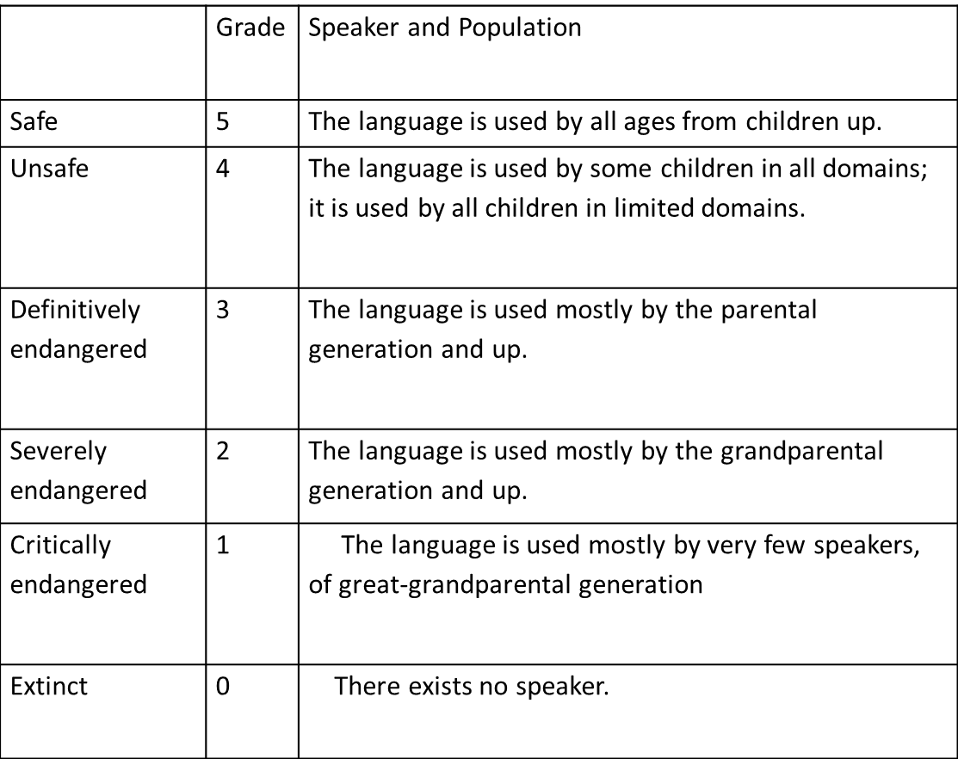
Degree of Endangerment:

Slide 33
Moribund:
Moribund language, a language likely to become extinct without intervention.
An example of moribund language in the Nigeria-Cameroon is Cambap .
An extinct language is a language that no longer has any speakers, or that is no longer in current use.
Language extinction and language death are often equated.
An extinct languages of Europe are:
Illyrian, Lemnian, Liburnian, and Paeonian
Extinct:

Slide 34
Attitudes and Values:
Ione is a young Samoan boy living in Australia. His family are very proud of their Samoan identity and culture and they take every opportunity to do things the Samoan way. They are part of an active Samoan community where the language is used regularly for church services and social events. Ione belongs to a Samoan Youth Club attached to the church. They play sport, organize dances, sing and write their songs, and go on regular trips - all of which he loves. Ione is proud to be a Samoan and its pleased his family taught him his language. For him, being Samoan means knowing how to speak Samoan.

Slide 35
Language shift tends to be slower among communities where the minority language is highly valued.
When the language is seen as an important symbol of ethnic identity, it is generally maintained longer.
Positive attitudes support efforts to use minority language in a variety of domains, and this helps people resist the pressure from the majority group to switch to their language.

Slide 36
The status of a language internationally can contribute to the positive attitude.
Maintaining French in Canada and the USA is easier because French is a language with international status.
It is obvious to French-Americans in Maine, that French is a good language to know. It has international prestige

Slide 37
Thank You
For Listening

